Slide 1

WHISPR-- A REAL TIME CHAT
APPLICATION
BY
YASA VARALAKSHMI
22STUCHH010322
SECTION B
MENTOR: K VARA PRASAD SIR

Slide 2
PRESENT EXISTING SYSTEM
In today's digital communication landscape, various real-time chat applications are accessible, including WhatsApp, Telegram, Slack, Microsoft Teams, and Messenger.A lot of platforms demand smartphone verification or are platform-dependent. limited incorporation of third-party tools such as currency
converters, weather forecasts, and language translators.
PROPOSED SYSTEM – WHISPR
A feature-rich, fully customisable, and API-integrated solution for individual or group communication, WHISPR is a contemporary, all-in-one real-time chat program designed to overcome the shortcomings of current systems.

Slide 3
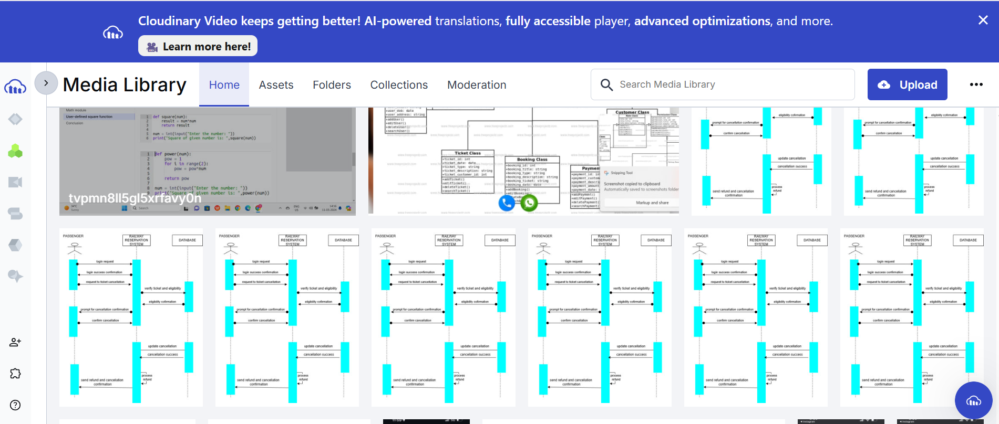
BACKEND
Node.js – JavaScript runtime for scalable server-side development
Express.js – Web framework for Node.js to build APIs and handle routing.
Socket.io (Server Side) – Handles real-time communication with low latency
Cloudinary – Cloud-based service for image upload, storage, and optimization

Slide 4
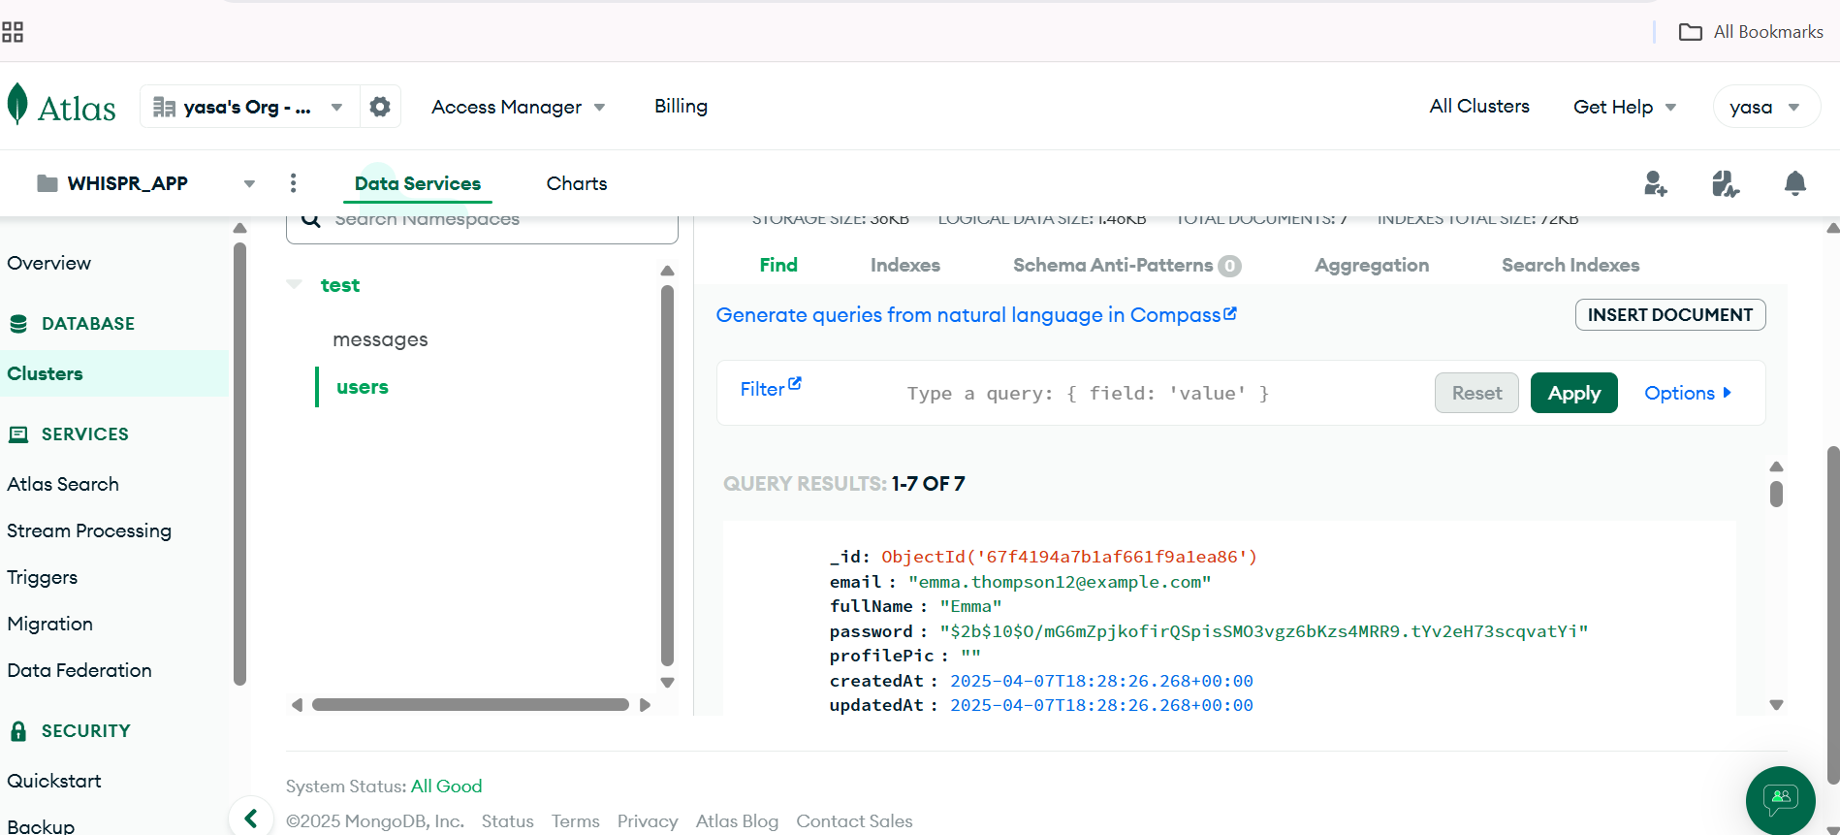
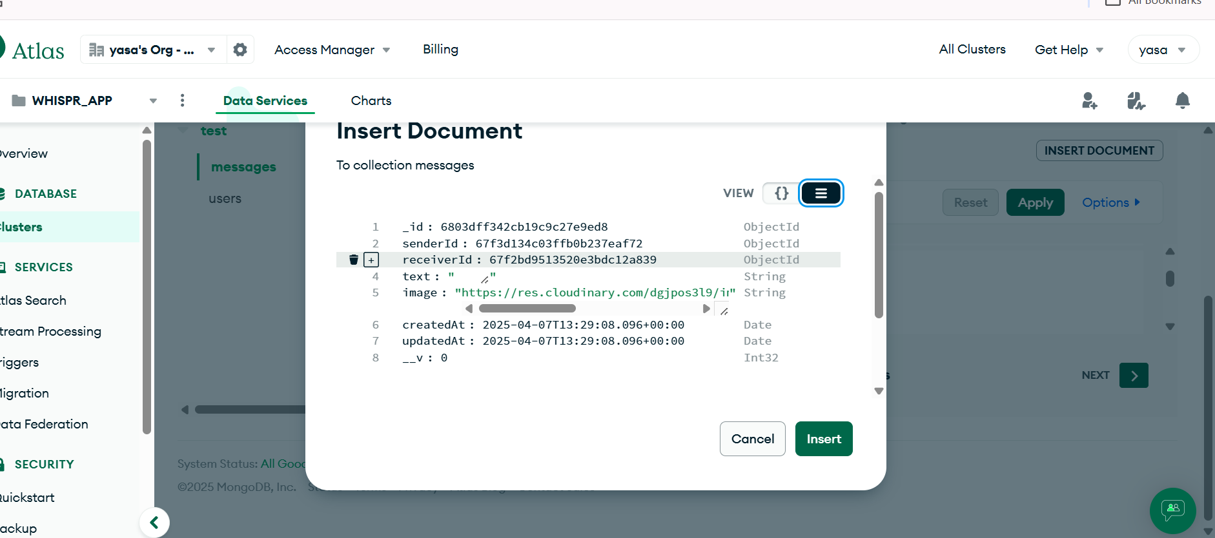
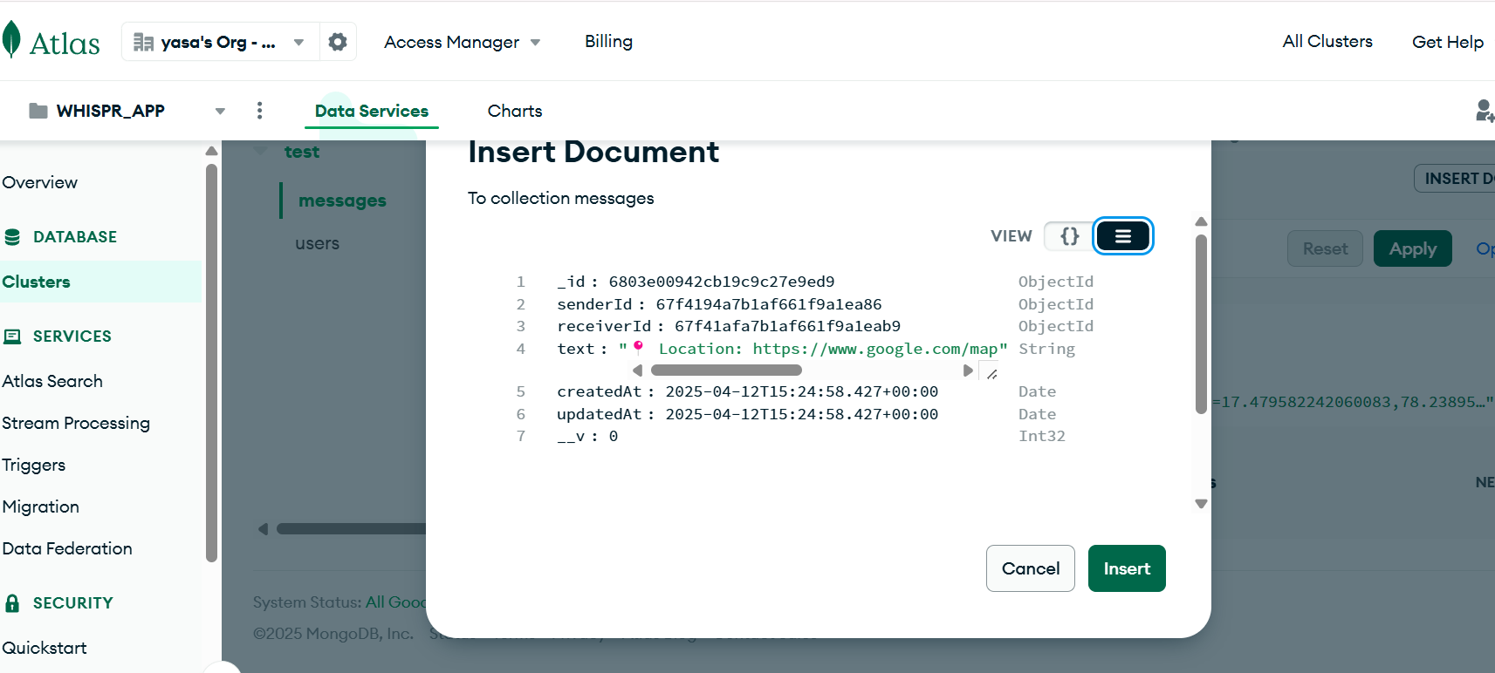
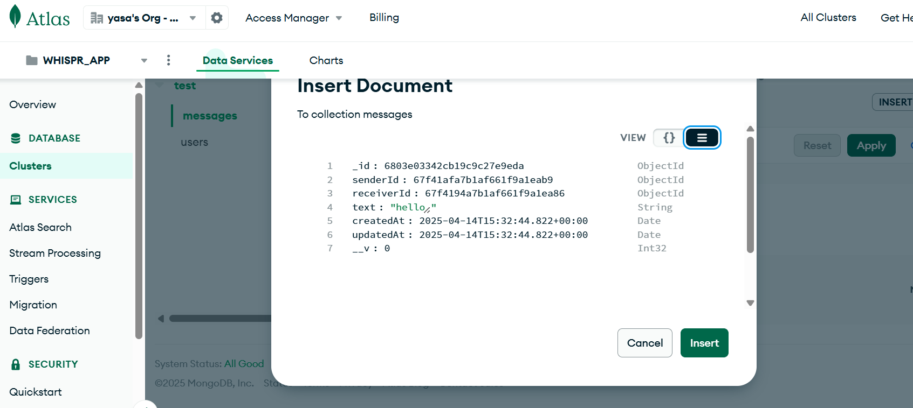
BACKEND
MongoDB – NoSQL database for storing user data, messages, and media references

Slide 5
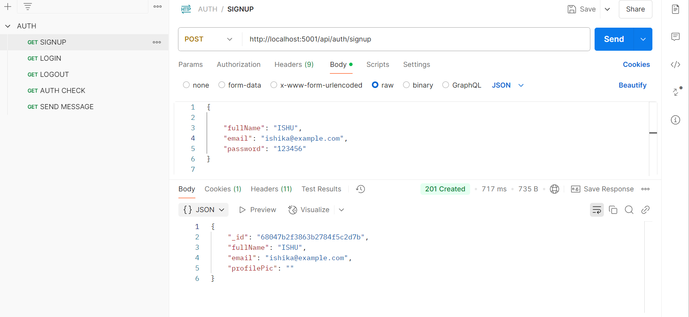
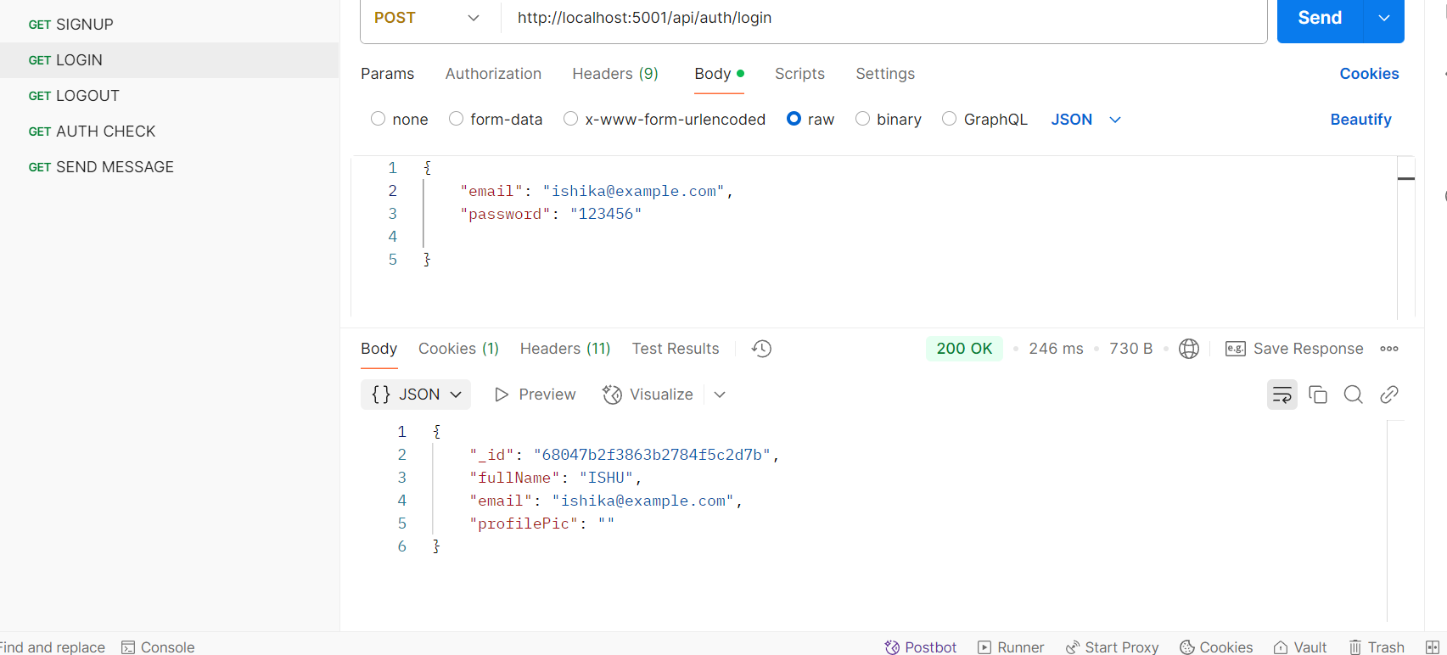
BACKEND
Postman – API development and testing tool to manage endpoints
SIGNUP
LOGIN

Slide 6
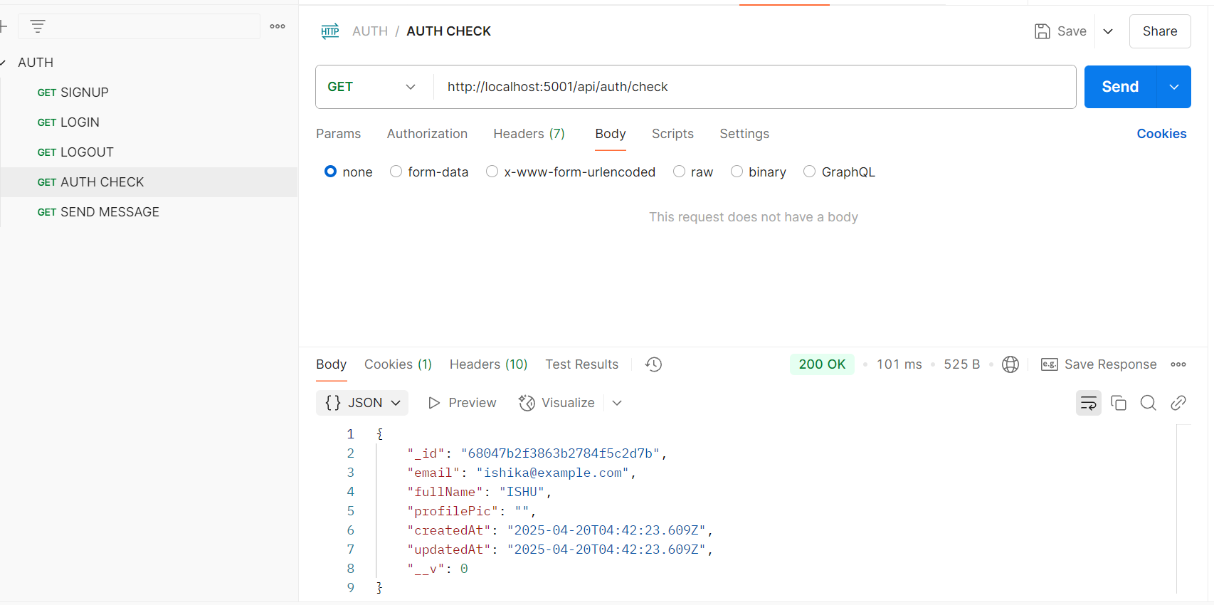
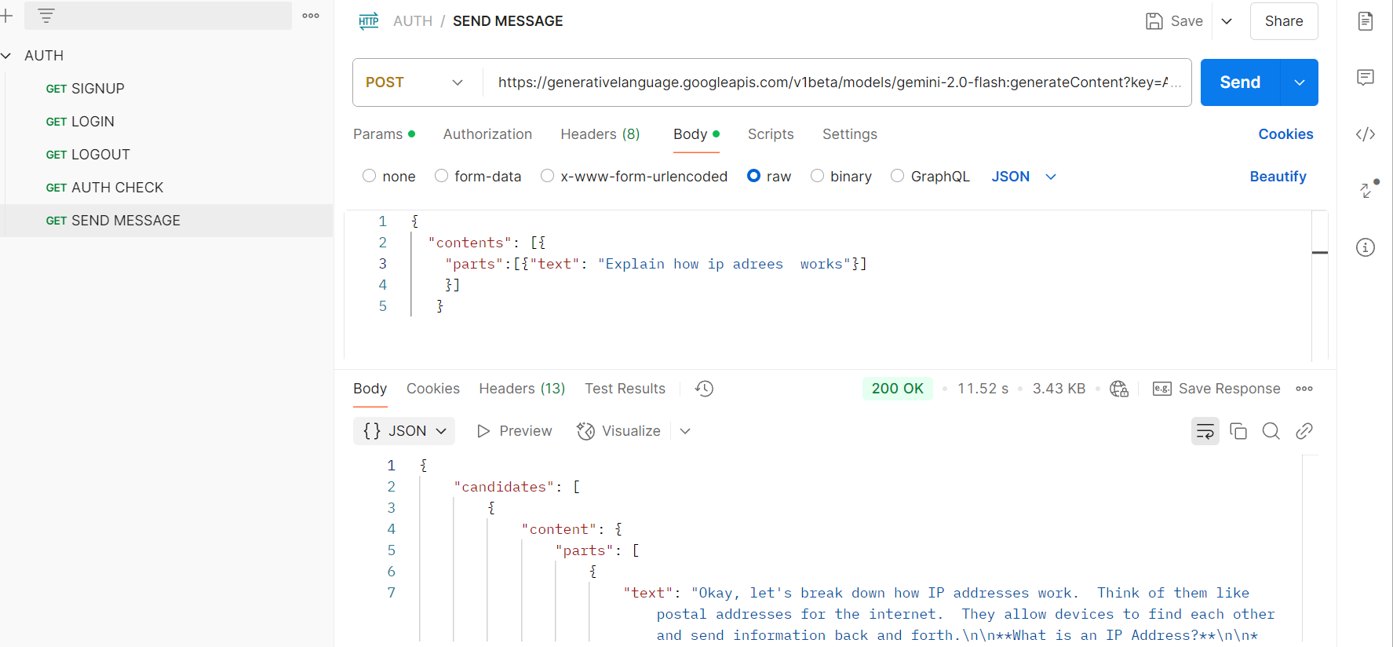
BACKEND
Postman – API development and testing tool to manage endpoints
AUTHU- CHECK
SEND MESSAGE

Slide 7
FRONTEND
React.js – For building dynamic and responsive user interfaces
Tailwind CSS – Utility-first CSS framework for fast and consistent styling
PostCSS – Tool for transforming CSS with JavaScript plugins
DaisyUI – Component library built on Tailwind CSS for pre- designed UI elements
Socket.io (Client Side) – Enables real-time bidirectional communication

Slide 8
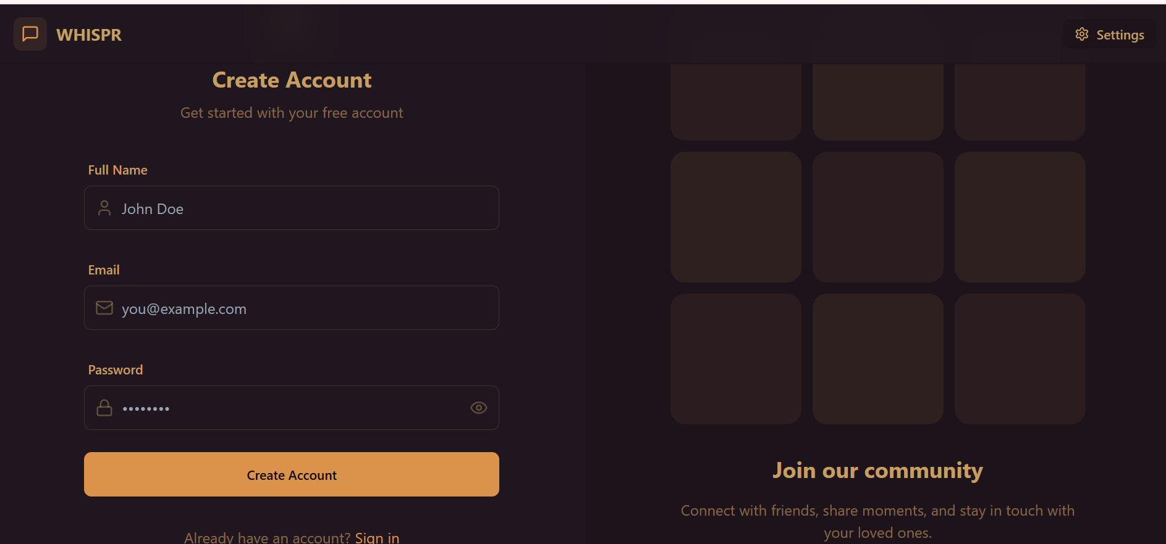
SIGNUP PAGE
WHISPR's Sign-Up page provides new users with an easy-to-use interface to create an account. To
register, users need to provide their full name, email address, and a strong password.

Slide 9
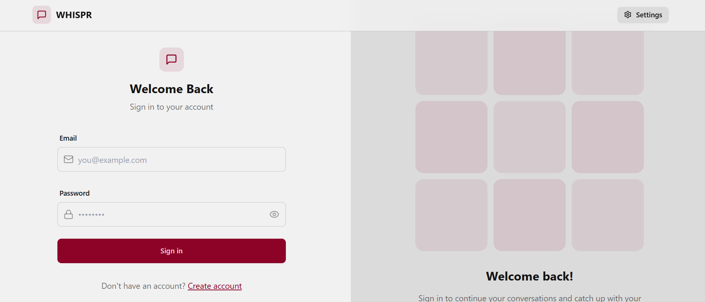
LOGIN PAGE
By entering their registered email address and password, current users can safely access their WHISPR accounts via the Login page. A JWT token is created to control the session after user credentials are
verified upon clicking the "Sign in" button

Slide 10
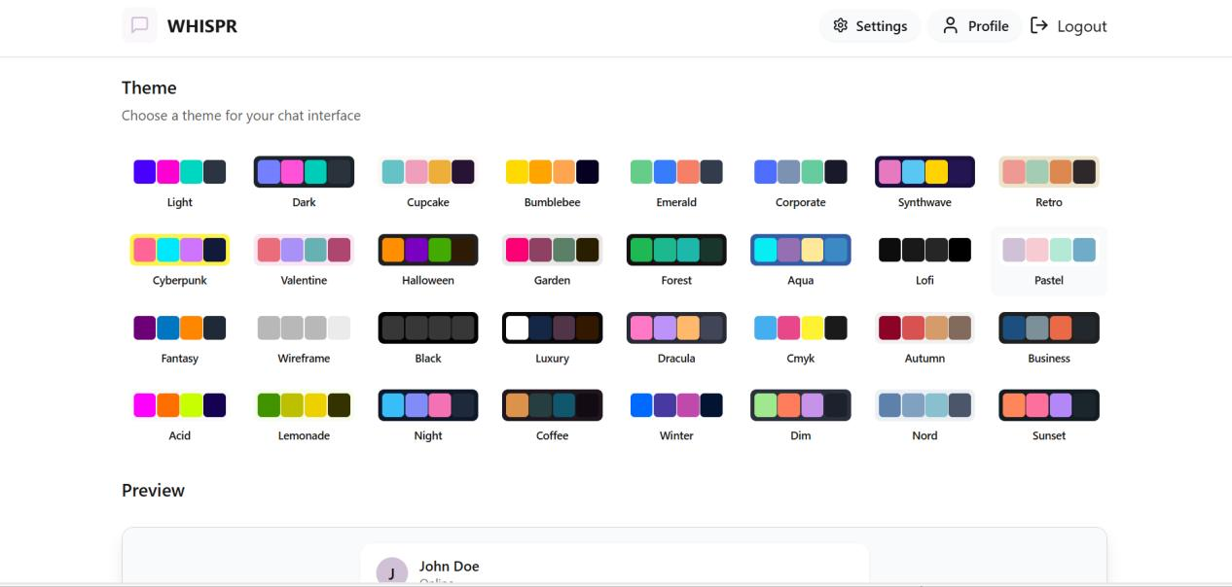
SETTINGS PAGE:
The settings page is accesile from all other pages as it is in the nav bar.By selecting from a large
selection of themes, including Dark, Light, Cyberpunk, Dracula, Retro, and more, users can alter the look and feel of their chat interface via the Settings page.

Slide 11
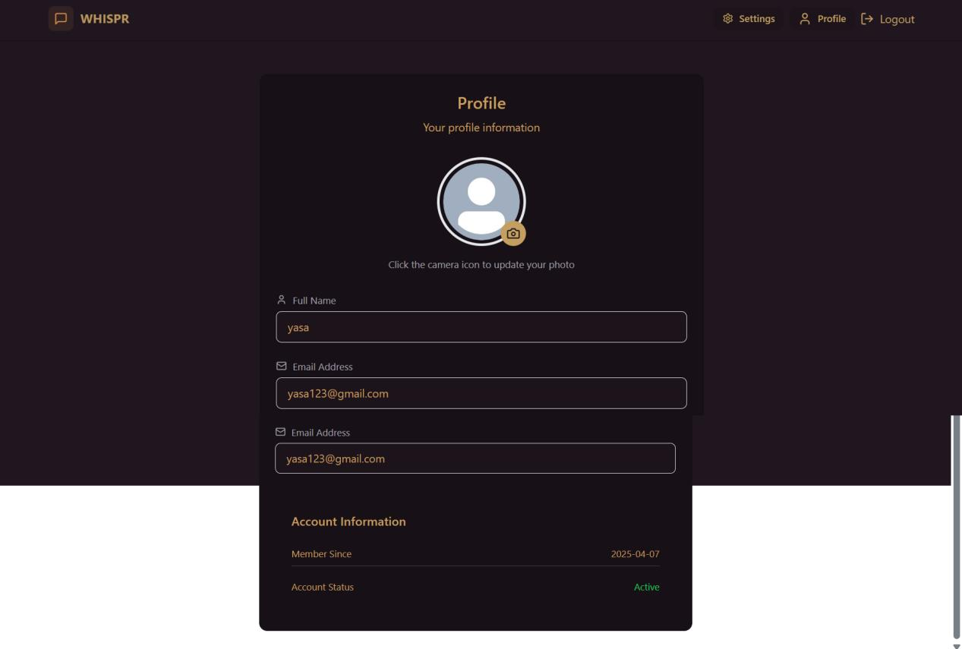
PROFILE PAGE:
A clickable camera icon allows you to upload or edit your profile picture.
Full Name, Email Address, Member Since,Account Status are the fields available in profile page.

Slide 12
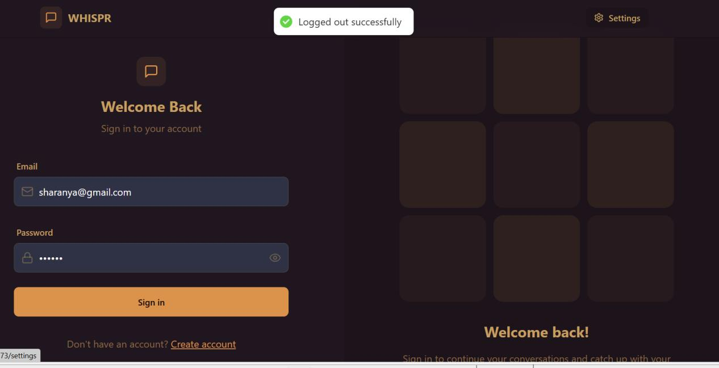
LOGOUT PAGE:

Slide 13
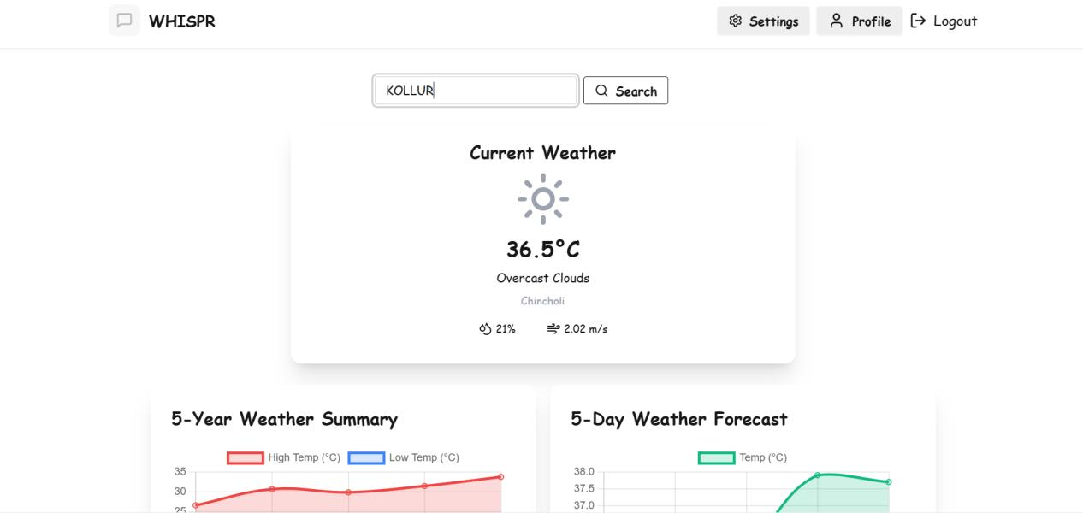
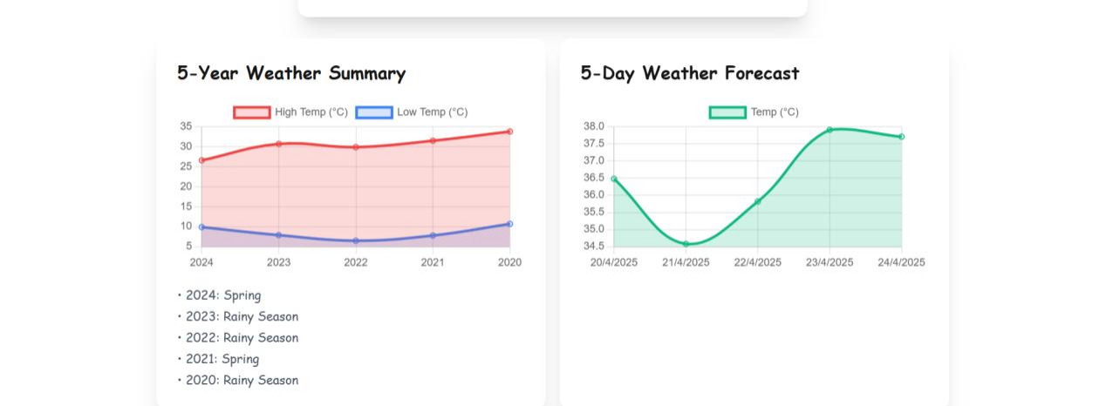
WEATHER :
To obtain weather information, I used the openweathermap API.

Slide 14
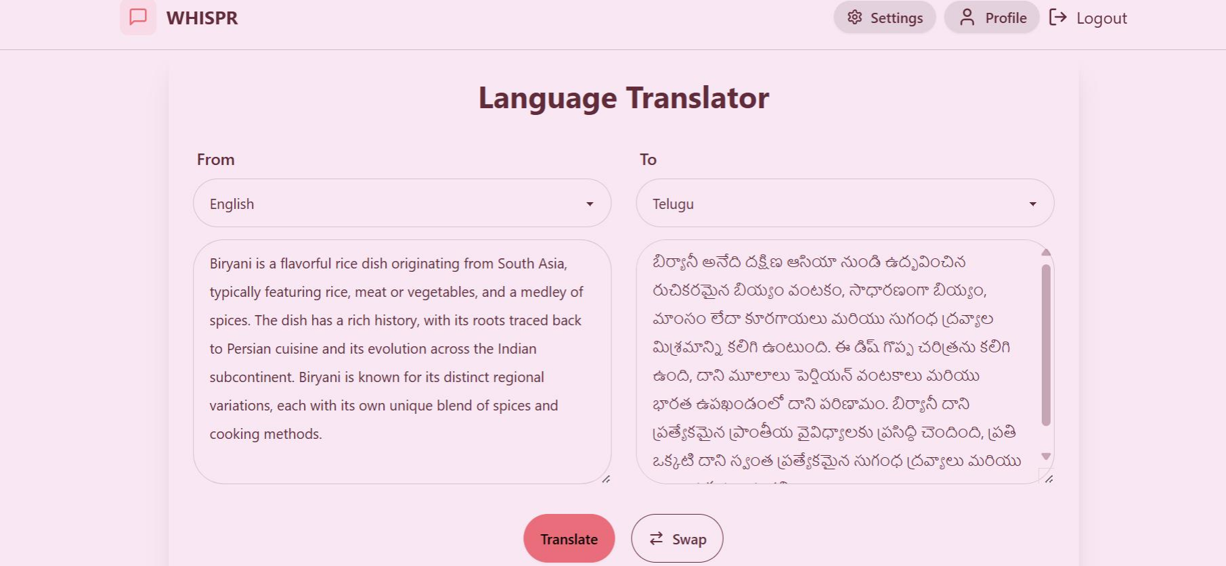
LANGUAGE TRANSLATOR:
The Language Translator in WHISPR makes use of the MyMemoryTranslated API (mymemory.translated.net) . It supports 98 languages and allows users to easily translate text across them. Users can enter up to 500 words at once.

Slide 15
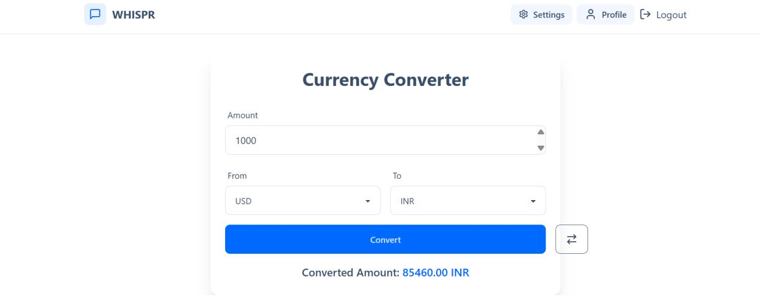
CURRENCY CONVERTOR:
The Currency Converter in WHISPR uses the Exchangerate API (api.exchangerate-api.com) to provide real-time currency conversions. It supports 41 currencies, allowing users to reliably convert between global currencies.

Slide 16
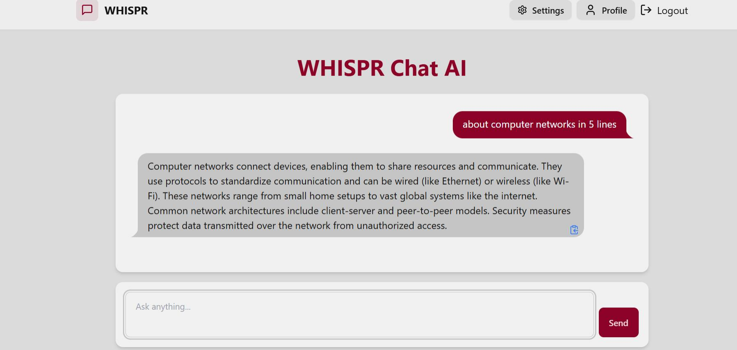
CHAT AI/ CHAT BOT:
The WHISPR Chat AI is an intelligent chatbot that uses the Gemini API to offer clever, contextual responses to user queries.

Slide 17
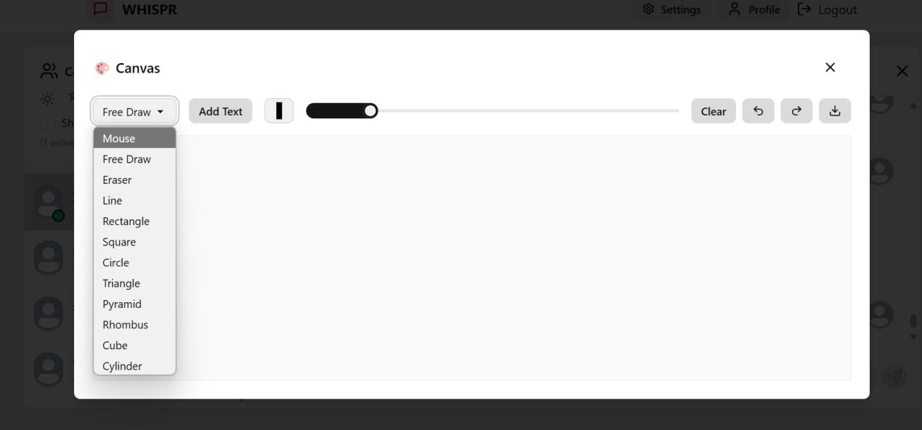
CANVAS:
This tool is great for rapid diagrams, visual explanations, shape drawing practice, and collaborative whiteboarding during sessions.

Slide 18
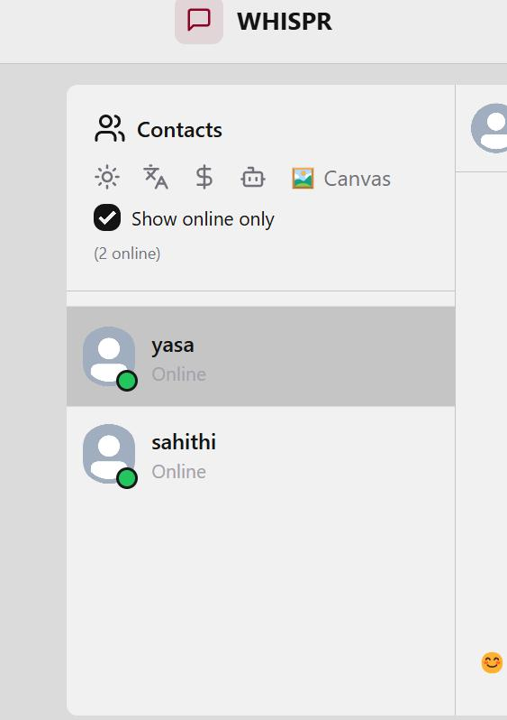
SHOW ONLINE USERS:
When I click on show online it shows me who are online.

Slide 19
SORTED USER LIST/CONTACTS:
getSortedUsers: () => {
const { users, lastMessages } = get();
return [...users].sort((a, b) => {
const aTime = lastMessages[a._id]?.createdAt || 0;
const bTime = lastMessages[b._id]?.createdAt || 0;
return new Date(bTime) - new Date(aTime);
});
},

Slide 20
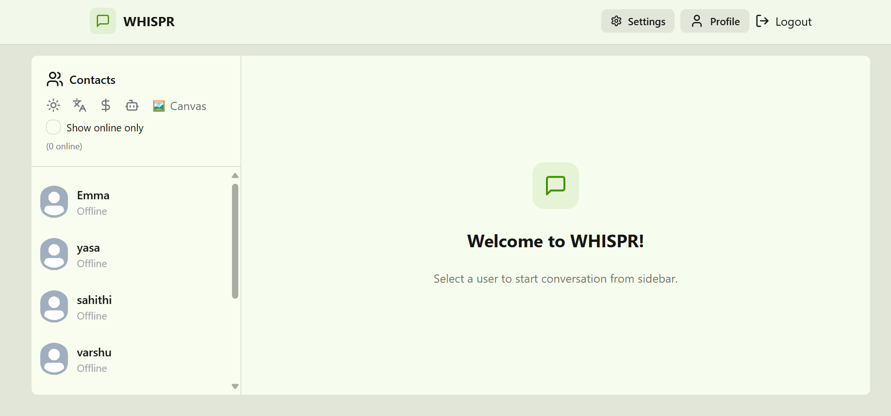
CHAT CONTAINER:
When No User is Selected:  The chat container displays a placeholder message:
"Select a user to start conversation from sidebar."

Slide 21
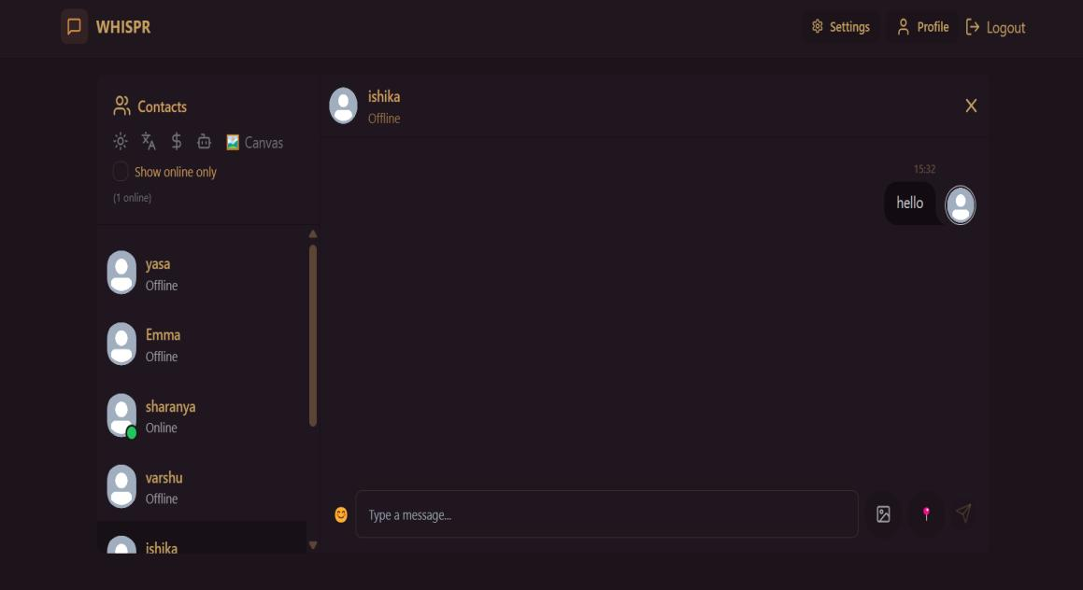
CHAT CONTAINER:
When a User is Selected:The full chat interface becomes active with the following features: 
Message Input Field, Emoji Picker, Image Sharing ,Live Location
Sharing ,Send Button.

Slide 22
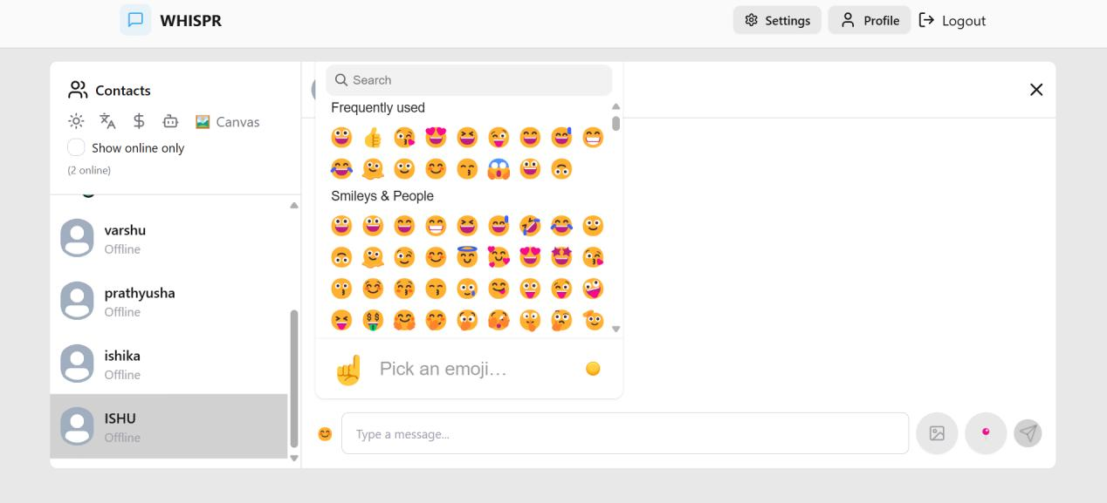
EMOJI PICKER:
WHISPR's emoji picker is built with the @emoji-mart/react library and emoji data from @emoji-mart/data.

Slide 23
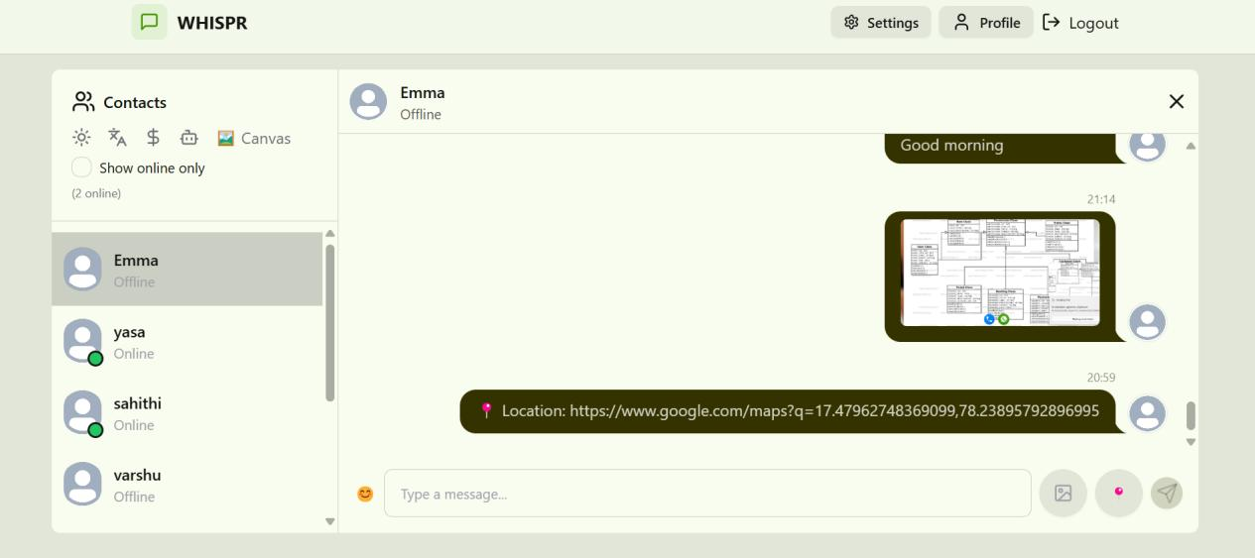
IMAGE AND LIVE LOCATION SHARING :
I have used Google Maps API to retrieve and share the user's current position.

Slide 24
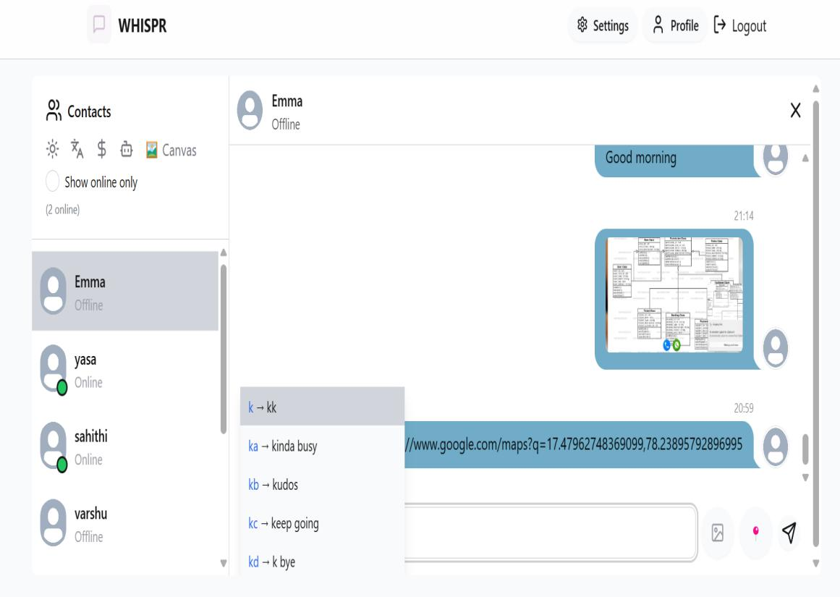
AUTO SUGGESTIONS:
This feature manages keyboard navigation for a 150-word-trained auto- suggestion feature. The active index Is updated and the filtered suggestions are cycled through when the user pushes ArrowDown or ArrowUp

Slide 25
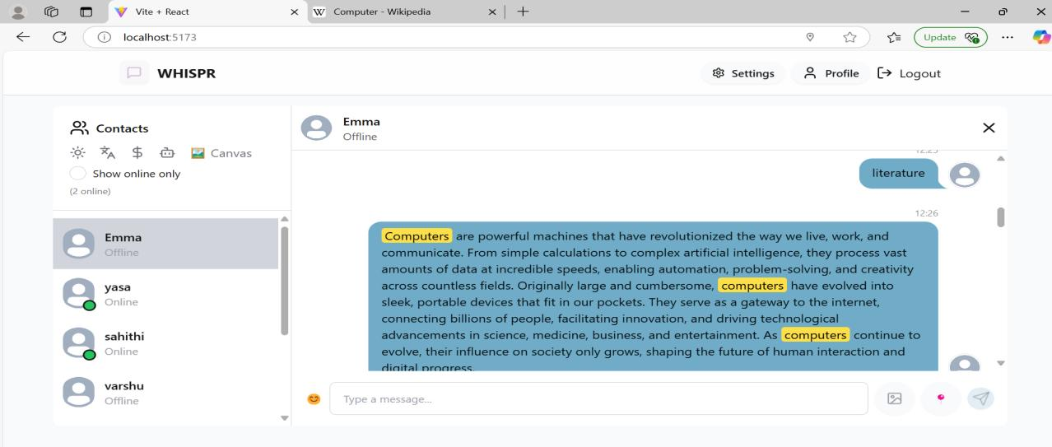
NOBOT:
WHISPR's NOBOT feature allows users to interact with any message for quick knowledge lookup. The event is
triggered when you right-click on a message or double-click a word or phrase.

Slide 26

THANK YOU

